Slide 1




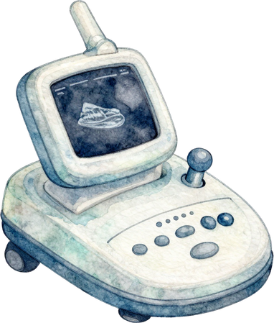

Unsupervised Anomaly Detection in Fetal Brain Ultrasound
MULTI-TIMESTEP SCORING AND AUTOMATED QUALITY ASSURANCE FOR MORE ROBUST ANOMALY MAPS
1

Slide 2

Contents
  Introduction
  Problem Statement
  Motivation
  Existing Systems
  Advantages & Limitations
2

Slide 3
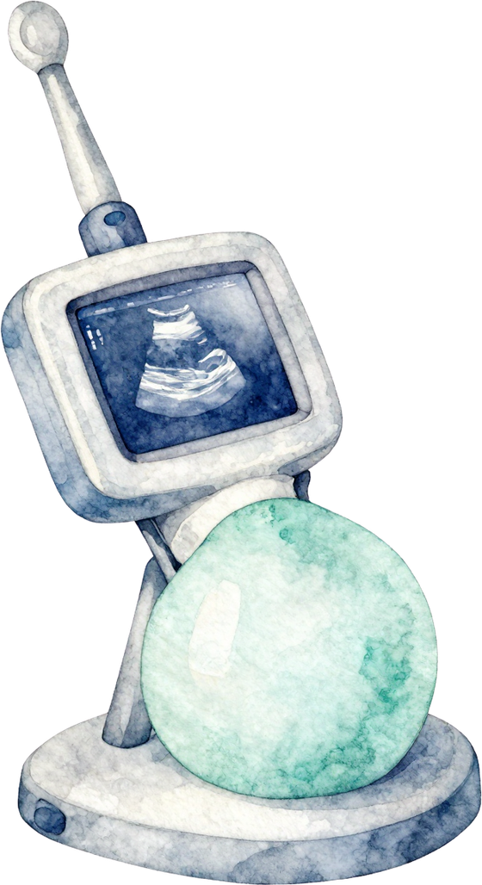
Introduction
Ultrasound (US) is the standard tool for prenatal care because it is safe, real-time, and low-cost.
The mid-pregnancy scan (about 22 weeks) is key for finding fetal brain anomalies.
Unsupervised anomaly detection (UAD) trains only on healthy scans and flags anything that deviates from normal anatomy
Image quality suffers from acoustic shadows, speckle noise, and motion blur.
Denoising diffusion models (DDPMs) generate a "pseudo-healthy" version of a scan. The difference from the original gives an anomaly heatmap.
3

Slide 4
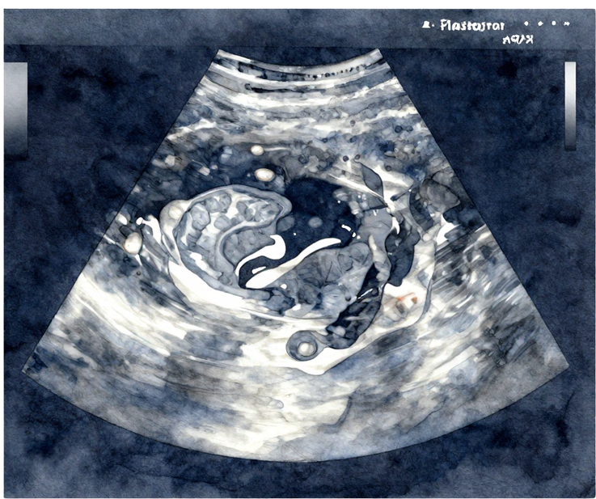
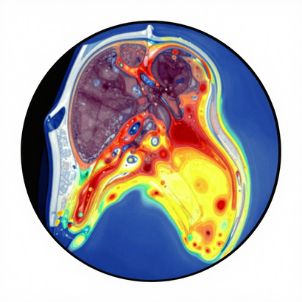
Problem Statement
“Detecting fetal brain abnormalities from ultrasound images is challenging due to the limited availability of labeled abnormal data. An unsupervised method is needed to learn healthy brain patterns and identify potential anomalies without requiring abnormal images for training.”
Goal achieved :
To develop and evaluate an unsupervised anomaly detection framework for fetal brain ultrasound that can detect potential abnormalities without requiring abnormal images during model training.
4

Slide 5
Motivation
Early detection of brain anomalies supports timely clinical decisions and counselling.
A label-free method can generalise to rare and unseen malformations.
Diffusion models succeeded in brain MRI, but fetal brain US is largely unexplored.
5

Slide 6
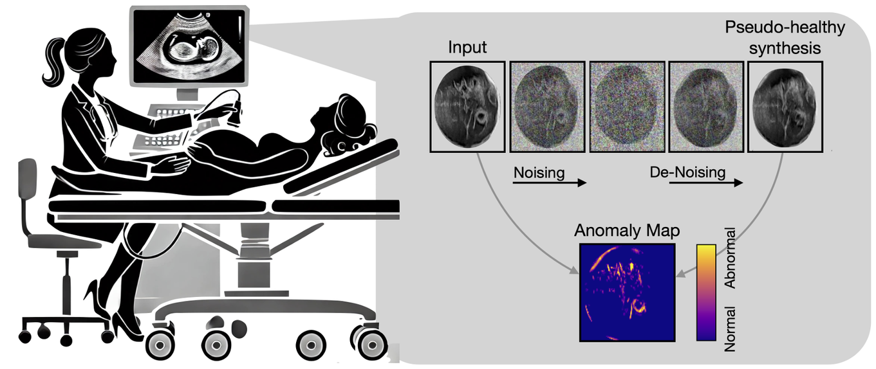
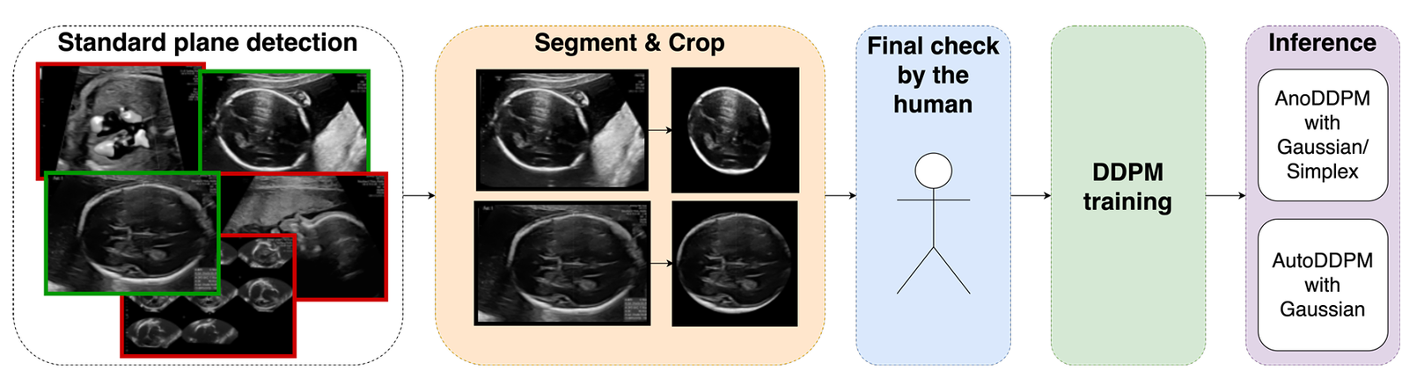
Existing System
6

Slide 7


Advantages
Limitations
  Unsupervised learning: Does not require abnormal images during model training.
  Reduces annotation dependency: Avoids the need for extensive expert-labeled anomaly data.
  Learns healthy patterns: The diffusion model learns the appearance of normal fetal brain ultrasound.
  Anomaly localization: Produces anomaly maps that can highlight potentially abnormal regions.
  Automated preprocessing: Uses standard-plane detection and brain segmentation to focus on the relevant region.
  Limited dataset: The study uses a relatively small curated dataset for training and evaluation.
  Image-quality dependency: Ultrasound image quality and acquisition variations can affect performance.
  False positives: Normal anatomical variations or image artifacts may be incorrectly identified as anomalies.
  Detection performance: The reported AUROC was 66.6% for the best AUPRC configuration, showing that further improvement is needed.
  Clinical validation required: The framework requires further validation on larger and more diverse clinical datasets before practical clinical use.
7

Slide 8
Thank You
8

